Slide 1
Three Short Presentations
Joan Dunham
July 26, 2020

Slide 2
SkyWatcher + QHY Camera
Joan and David Dunham

Slide 3
Example of Preparation to Observe
16” SkyWatcher GOTO scope
Collapsable Dobsonian
Used as a transportable scope, not on a fixed mount
Used and stored on a Scope Buggy
QHY 174 GPS Camera
Data capture with SharpCap
RunCam Mighty-Mini Finder
Display to portable video screen or Win10 tablet with IOTA Video Capture
TalentCell 12V/6000mAh batteries
2 - one to power the scope, the other for the cameras
Dell Laptop running SharpCap for data collection

Slide 4
Steps in Preparation to Observe
Collimate the scope
Attach the camera and finder and adjust the finder, if needed, to align with the telescope
Perform star alignment of the telescope
Find the target
Record the event

Slide 5
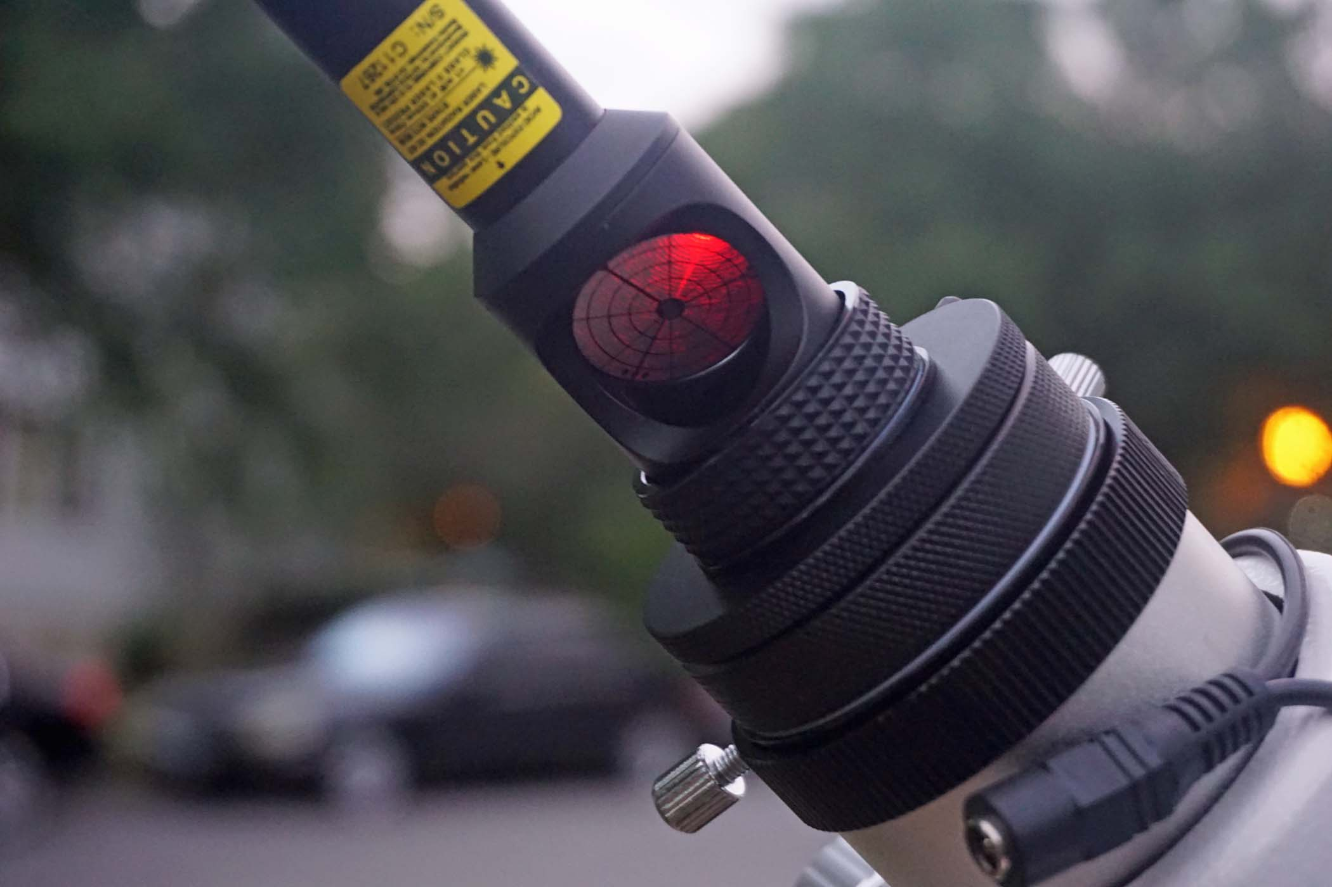
Collimate
Collimate first, before powering the telescope
Collimate this scope every time
Collimate carefully, it is possible to pop the primary completely out if the screws are run close to their limits

Slide 6
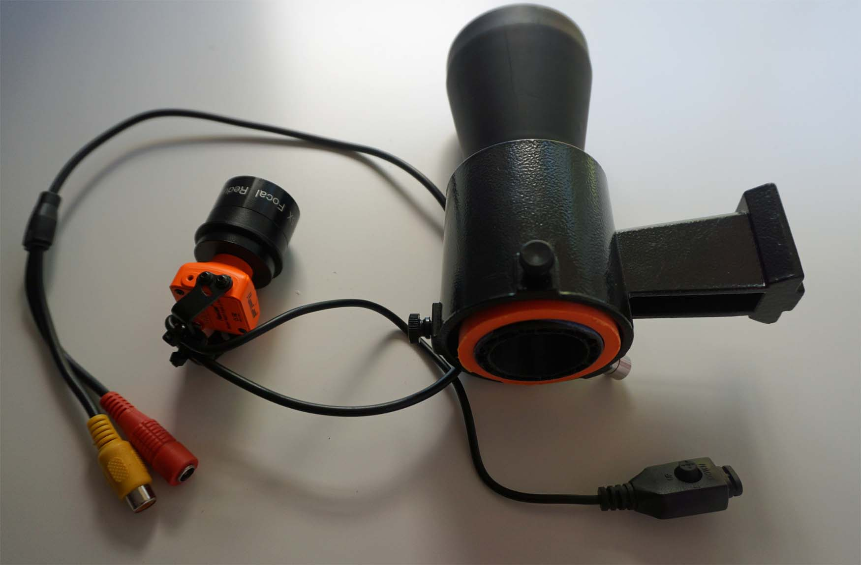
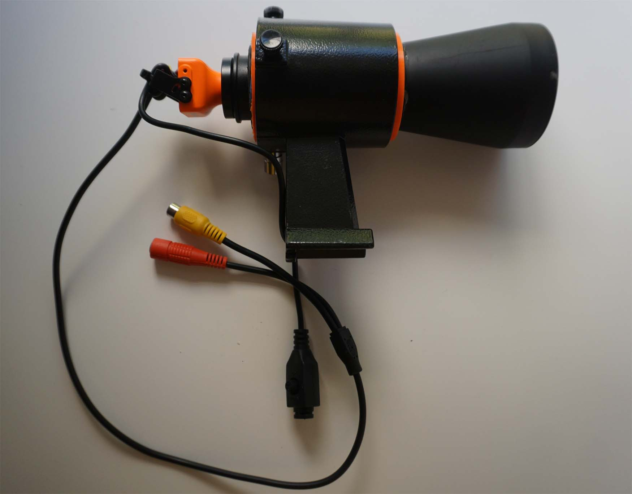
Video Finder
RunCam NightEagle 2 “Astro Edition”
Mighty-Mini
Finder-scope version
Cylinder built with a 3-D Printer by J. Moore
Alignment to scope
Check with bright object – Moon or Jupiter
Mark the center of the scope FOV on the finder video display with painter’s tape
If scope FOV not on the finder – check the finder for attachment or other problems

Slide 7
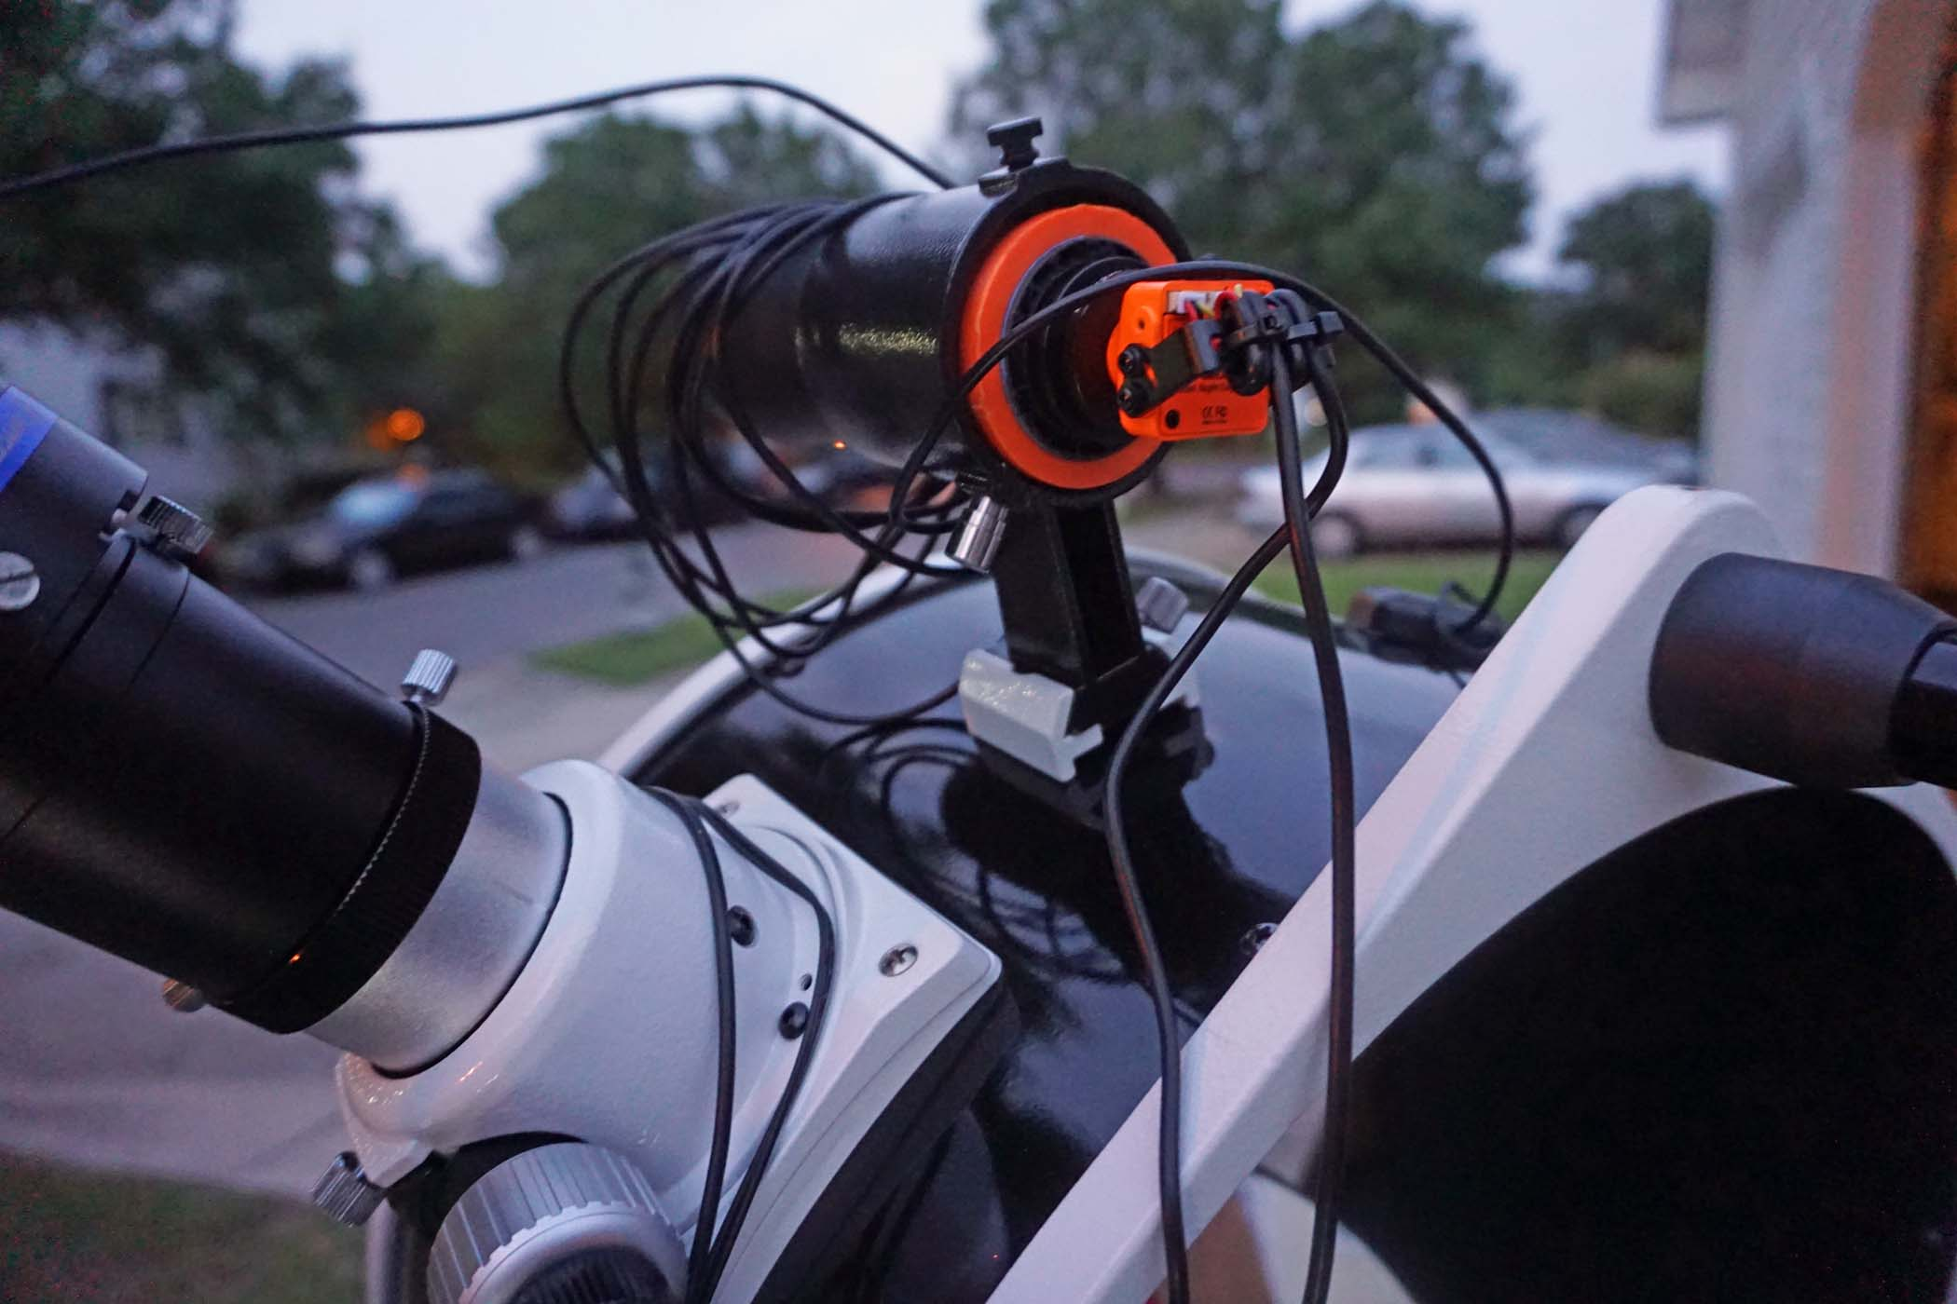
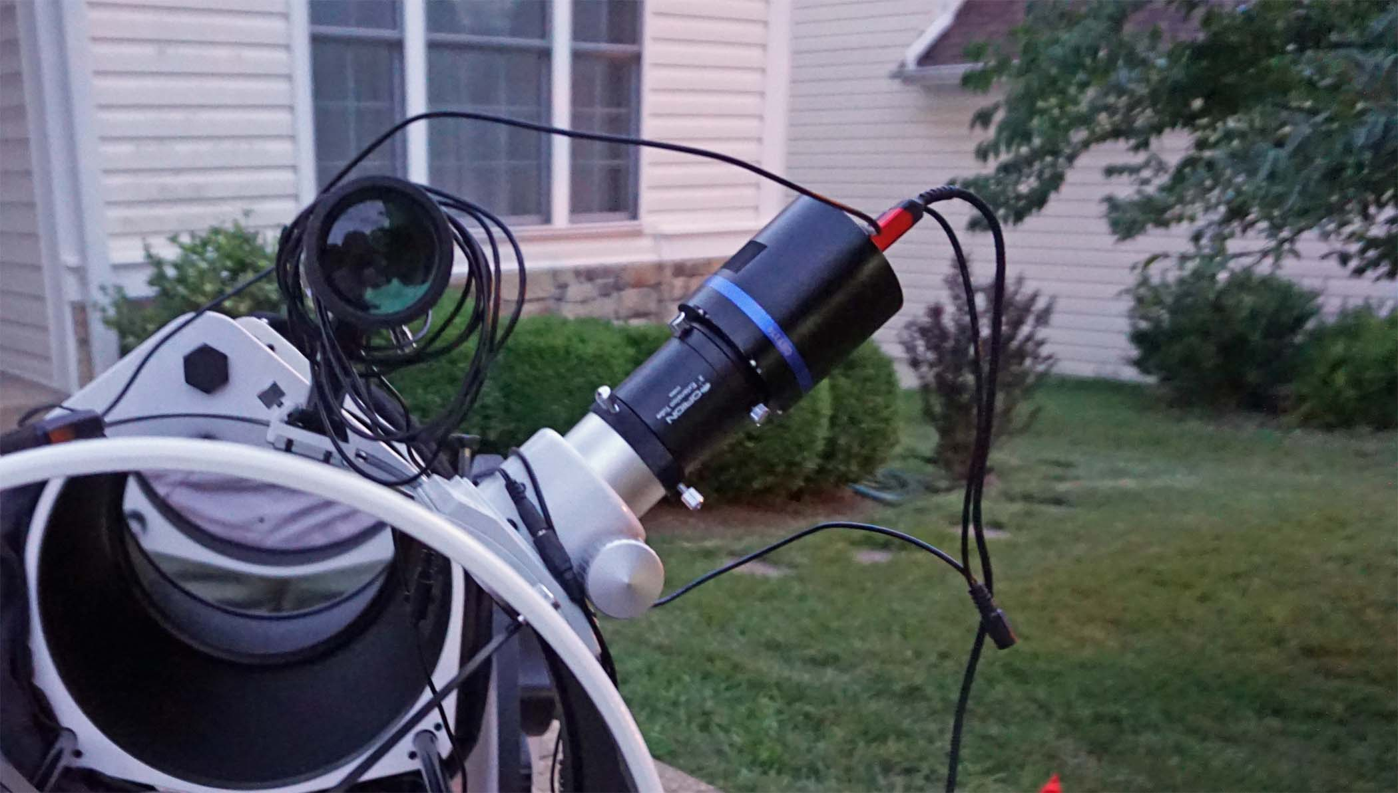
Camera and Finder Attached
Note the number of cables and cords – 2 power cords, video cable, USB cable, GPS antenna cord

Slide 8
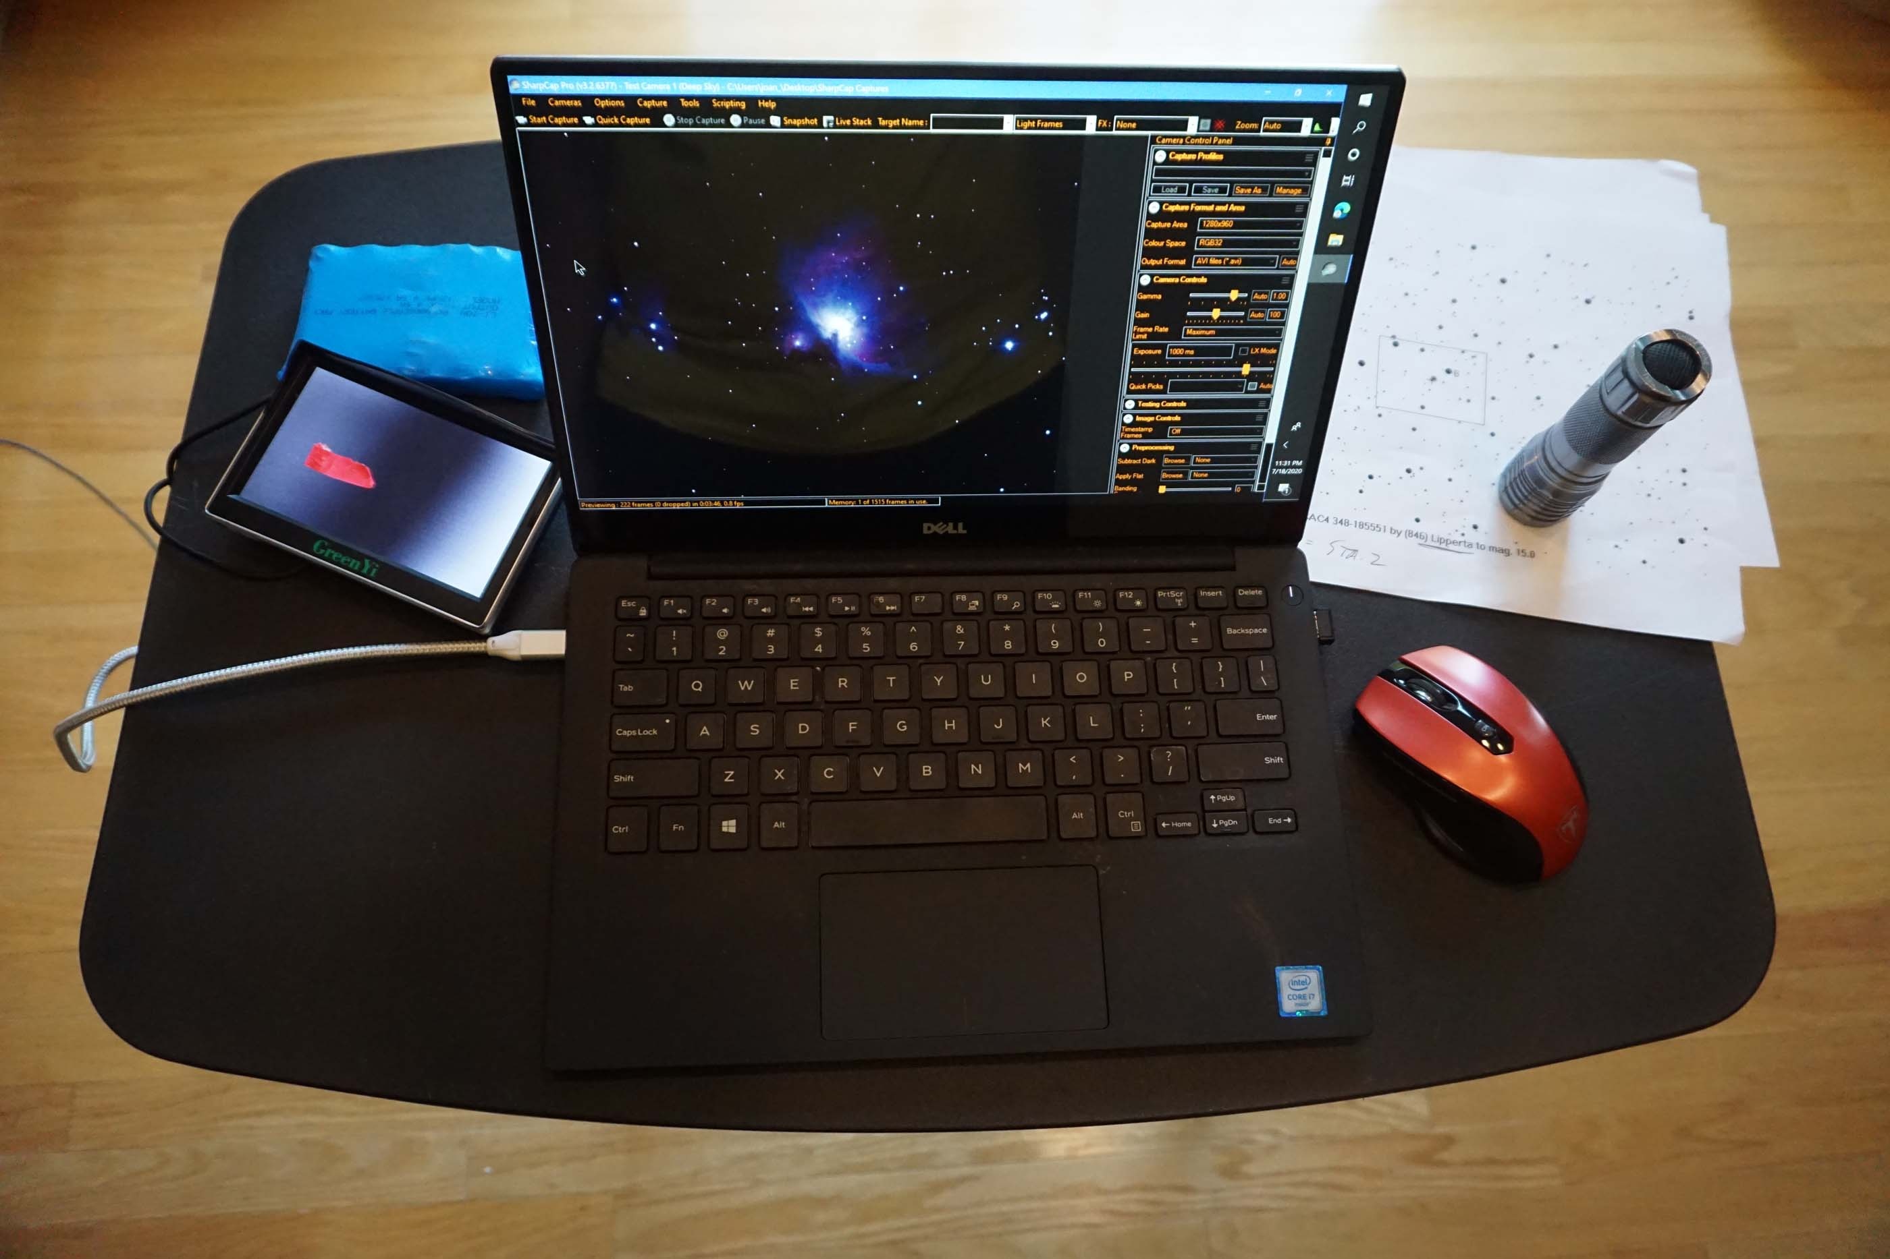
Observing Table
Freestanding
Holds
Video display + battery
Finder charts
Laptop running SharpCap + mouse
Flashlight
Must be moved with the scope when it slews
Avoid stress on the camera cables
Requires 2 people, one to operate the scope, the other to carry the table

Slide 9
Align the Scope
2-star alignment preferable for asteroidal occultations
Check alignment by commanding scope to another, nearby, target
Use PAE (position accuracy enhancement) if it is close but not close enough
Things that can go wrong
Mis-identification of an alignment star; some stars have other bright ones nearby
Coordinates or date/time entry error on set-up

Slide 10
Find the Target
Tools to use
Scope’s catalog if it has the target star
Finder charts + add the target star position as a user object
Google Sky to augment the finder charts
Problems
Target area doesn’t match finder charts
Camera is red sensitive, red stars are brighter/blue stars fainter than catalog visual mag
Asteroid in FOV can look like an unexpected star
More stars in the FOV than on the finder charts – Google Sky will show them
On target area, don’t see target, and event time is close
Increase exposure and/or gain
Take the data anyway – postprocessing may find the target

